Slide 1



Data Science Methods for Cutting-edge Tec
Knowledge and solutions for a changing world
Advancing data-intensive discovery in all fields
Be boundless
UW DIRECT
https://uwdirect.github.io
Ting Cao
Materials Science & Engineering

Slide 2
What are statistics?
Let’s look at some exerts from recent news:
Good but not great:
Country A’s GDP is expected to grow 2.3% in 2019
Country B’s economy is in trouble:
Economists expect to see 6.95% annual GDP growth in 2019.
Are these judgments trustworthy?
Notes:
GDP: Gross domestic product (one of the core economic indices to measure the scale of economic growth)

Slide 3
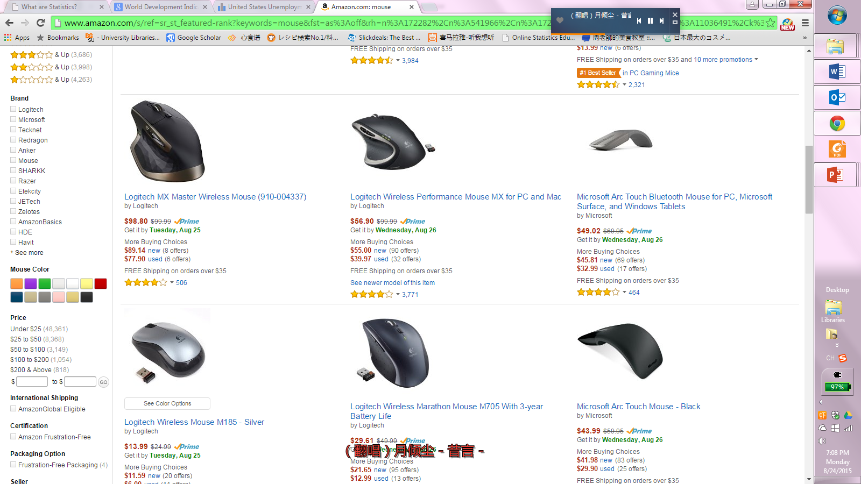

What are statistics?
Let’s look at an example that may be closer to us:
Which one would you buy?

Slide 4
What are statistics?
Statistics are NOT just facts and figures
They are techniques and procedures based on which we:
Analyze data,
Organize data and results,
Interpret results,
Make decisions.
Survey: Experience with statistics?

Slide 5
Why is good statistics beneficial?
Let’s get back to the exerts from recent news:
Good but not great:
Country A’s GDP is expected to grow 2.3% in 2019
Country B’s economy is in trouble:
Economists expect to see 6.95% annual GDP growth in 2019.
Pay attention to the base rate!
If you know that the Country A’s GDP amounts to $17 trillion in 2018, whereas at the same period Country B’s GDP amounts to $10 trillion, what would you say?
Are these judgments trustworthy?
Notes:
GDP: Gross domestic product (one of the core economic indices to measure the scale of economic growth)

Slide 6
Why is good statistics beneficial?
And the example about shopping decision:
Pay attention to the sample size!
Do you trust larger sample (mouse 1 with 3771 rates) or smaller sample (mouse 2 with 123 rates)?
Which one would you buy?

Slide 7
Why is good statistics beneficial?
Help us avoid biased judgment and make better decisions
And why is it important for science?
Science needs to be honest and unbiased.
Statistics help scientists organize and communicate their findings.

Slide 8
Sample
Sample helps to answer questions about the population
Population: the ENTIRE group being studied
All unemployed & employed people in the US
Sample: PART of the population being studied
The selected unemployed & employed people across different states in the US
Our data come from populations, but in statistics, we care most about samples.

Slide 9
In simple words
Statistics is the method of studying population based on samples
Populations
We use parameters to describe populations
Samples
We use statistics to describe samples
The sample has to represent the population

Slide 10

Sample
In order to do be representative, the sample needs to be:
Large enough → large sample size
Random sampling → avoid bias
However, no samples are perfect
You need to allow room for errors
→ Sampling error
Unemployed people in Washington?
Unemployed people across different states in the US

Slide 11
Sampling Error
The discrepancy between a sample statistics and a population parameter
Arises when the sample doesn’t perfectly represent the population
Which sample is less representative?
Which sample has larger sampling error?
Sample #1
Erin
Brent
Jessie
Stephen
Amanda
Sample Statistics
Average IQ = 114.6
60% Female, 40% Male
Sample #2
Michael
Erise
Andrew
Katie
Blake
Sample Statistics
Average IQ = 104.2
40% Female, 60% Male
Population: 1000 College Students
Population Parameters
Average IQ = 112.5
65% Female, 35% Male

Slide 12
Basic Divisions of Statistics
Inferential Statistics
making inferences and conclusions about population based on the sample
A large part of inferential statistics is defining and measuring sampling error
Descriptive statistics
Describe our sample: organize and summarize
E.g., central tendency & variability of our sample

Slide 13
Population Sample
Population
The sample is selected from the population
Sample
The results from the sample are generalized to the population
All the individuals of interest
The individuals selected
Inferential statistics
Descriptive statistics
And this is the gist of statistics
Notes:
Continuum of population vs. sample

Slide 14
Descriptive statistics
Key concepts:
Central Tendency
Variability

Slide 15
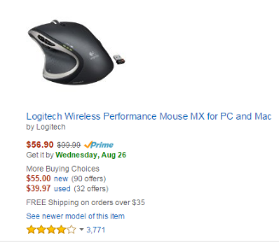

Central Tendency
Averaged ratings!
Amazon takes the ratings from all raters, and then average these ratings as representative of all ratings.
Where do the “stars” come from?
Can you see all ratings?

Slide 16
Central Tendency
What is it?
A descriptive statistic used to determine a single value that
accurately describes the center of the entire data set
Best represents the entire data set
GOAL
To summarize the data set into a single value
Make it possible to compare across different data sets (by comparing their central tendencies)

Slide 17
Central Tendency
Let’s use an example similar to what you may be familiar with:
At first sight you may say: Sample 1.
But what if you know this:
Which sample did better in the IQ test?
Sample #1
Dave (IQ = 175)
Ting (IQ = 85)
Jessie (IQ = 90)
Sample Statistics
Average IQ = 116
Sample #1
Dave
Ting
Jessie
Sample Statistics
Average IQ = 116
Sample #2
Michael
Erise
Andrew
Katie
Blake
Stephen
Amanda
Sample Statistics
Average IQ = 105.4
Sample #2
Michael (IQ = 105)
Erise (IQ = 106)
Andrew (IQ = 102)
Katie (IQ = 110)
Blake (IQ = 100)
Stephen (IQ = 110)
Amanda (IQ = 105)
Sample Statistics
Average IQ = 105.4
Pay attention!
Extreme outliers can be influential
Average is not the only way to obtain central tendency

Slide 18
Central Tendency
That’s why we have different types of statistics for central tendency
Mean
Median
Mode
You need to specify the type of statistic you use to obtain central tendency
E.g., the mean of the age of all students at UW (instead of “the center of the age……”)

Slide 19
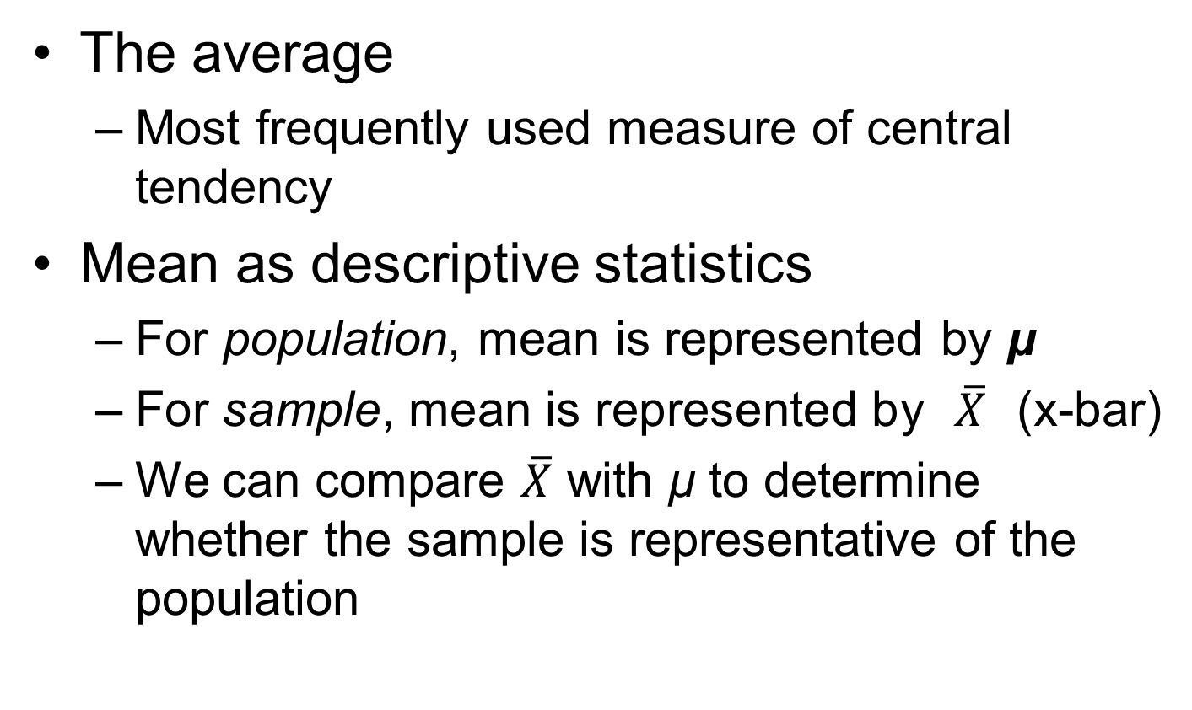
Mean
The average
Most frequently used measure of central tendency
Mean as descriptive statistics
For population, mean is represented by μ
For sample, mean is represented by $\overline{X}$ (x-bar)
We can compare $\overline{X}$ with μ to determine whether the sample is representative of the population

Slide 20

Mean
How to calculate:
For population, mean equals the population sum divided by population size (N).
μ $=\frac{\sum{X}}{N}$
Σ (Greek letter sigma) means “the sum”
X: observed numbers in the sample
Σ(X) = Sum of all Xs
For sample, mean equals the sample sum divided by sample size (n).
$\overline{X}$ $=\frac{\sum{X}}{n}$

Slide 21

Sometimes mean is not meaningful
When we have outliers
Outliers are data points that are extremely different from the mean
Example:
Average assets of UW faculty members is, say, $500,000.
Then Bill Gates decided to come here and teach, bringing in an additional asset of $50 billion…
Now the average assets of UW faculty might be the highest in the world (amount to millions, maybe)
But, is the new mean really meaningful??

Slide 22
Alternative 1: Median
The midpoint of an ordered set of data
The order of smallest to largest or vice versa.
50% of all data are greater than the median
Another 50% are lower than the median
Attention!
In order to use median, data must be able to place in rank order

Slide 23

Why median?
Sometimes median can be a good alternative to mean
e.g., when you have extreme cases in the dataset
Relatively unaffected by extreme data point
Even if Bill Gates came, the median of UW faculty’s asset won’t change much.

Slide 24
How to calculate the Median
Can be found by counting
List all data in rank order (smallest → largest or largest → smallest)
If n is odd, then the median is in the middle
If n is even, then the median is the average of the middle two data points

Slide 25
But…
Sometimes, even median does not help much
E.g., instead of just inviting Bill Gates, UW replaced 1000 staffs with 1000 millionaires around the world
UW has 5800 academic staffs in total
The 1000 millionaires makes up a large part
Driving the median asset to be much, much higher
So, when you have disproportionate extreme numbers in your dataset, median does not work either…

Slide 26
Alternative 2: Mode
The most frequently occurring data
Why is mode useful?
Getting back to the UW millionaire example
Even if UW had 1000 millionaires coming in, their personal assets can hardly be the same
But the other UW staffs have relatively stable income, which makes it more likely that their amounts of personal assets are quite similar
Thus, using the mode of personal assets can be better representative

Slide 27
Mode Weirdos
A dataset can have more than 1 modes
However, a dataset can only have 1 median and 1 mean
You may have many modes when your data is really spread out
E.g. Find the mode for this sample : 1, 2, 3, 4, 5, 6, 7, 8, 9, 10, 11
All of the data are modes
This is when mode is not helpful as central tendency

Slide 28
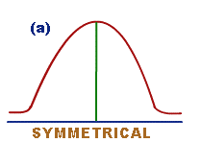
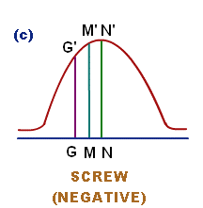
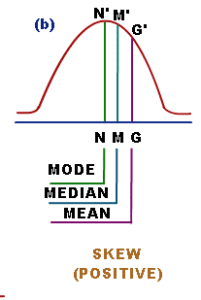
Mean vs. Median vs. Mode
Can be systematically related to one another
Sometimes they are the same number in the dataset
E.g., normal distribution
Sometimes they are different numbers in the dataset
Mode: peak
Mean: toward the larger or smaller end
Median: usually between the mean and the mode

Slide 29
Central Tendency & Variables
Not all dataset allow us to use all central tendency measures
Can you get a mean when there is no numbers?
E.g., the mean for the brands of cars in UW parking lots?
We need to consider
what central tendency measure(s) to use based on different types of variables

Slide 30
Variable & Data
What is a variable?
The focal subject/entity in our research question
E.g. the brand of cars parked in UW parking lots
When we try to quantify our variable, we have data
Through measurements or observation
E.g., height (variable) → a list of height for people in our class (data)
When you measure/observe for multiple variables, you get a dataset

Slide 31
Discrete vs Continuous Variables
Discrete
Categorical
E.g. BMW, Buick, Ford, Honda, Toyota…etc
Ordinary
E.g., freshman → sophomore → junior → senior
Can be numerical, with number representing the rank order
Continuous
Numerical, infinite, continuous
Can be put on a continuous continuum (e.g. age)
Can be transformed categorical or ordinary variable
E.g. young vs old.

Slide 32
Central Tendency & Variables
Getting back to where we began:
To calculate mean, we need:
Continuous variables
To calculate median, we need:
Either discrete variables or continuous variables, but have to be ordered
To count for mode, we need:
Either discrete variables or continuous variables

Slide 33
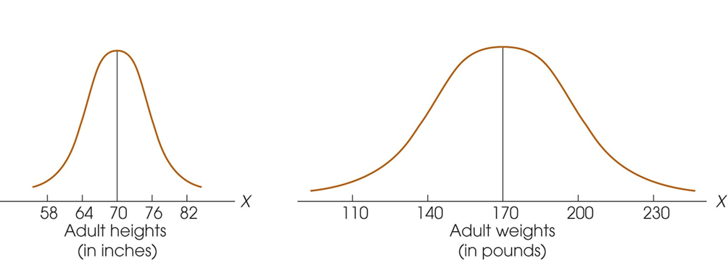
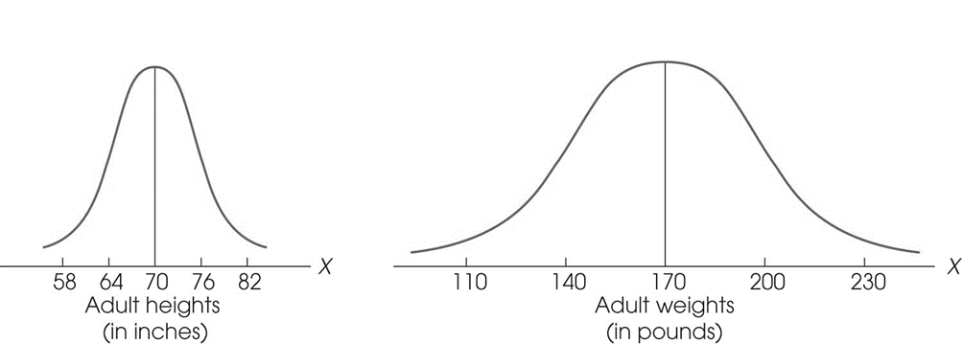
Why variability?
Central tendency is not enough
Different samples can have the Same central tendency (mean, median, mode)
e.g., individual weights for students in UW vs. students in MSE department

Slide 34
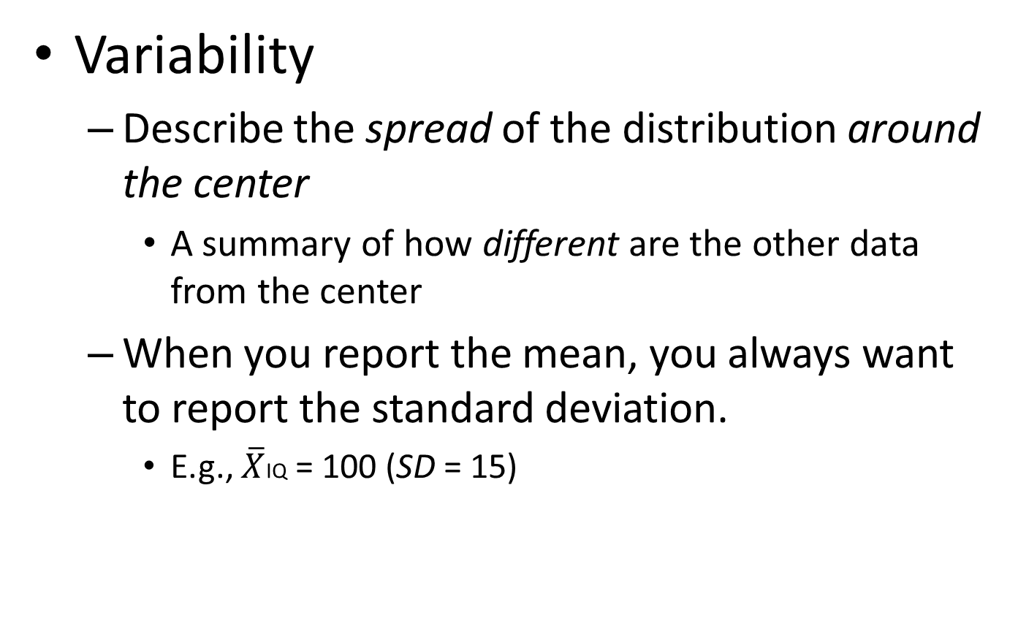
What is variability?
Variability
Describe the spread of the distribution around the center
A summary of how different are the other data from the center
When you report the mean, you always want to report the standard deviation.
E.g., $\overline{X}$IQ = 100 (SD = 15)

Slide 35
What is variability?
Variability as both descriptive & inferential measure
Descriptive Statistics:
Variability measures the degree to which the variables are spread out in the dataset
Inferential Statistics:
Variability provides a measure of how accurately a sample represents the population
Large variability → not accurate → can’t generalize

Slide 36
Measuring Variability
Range
Difference between the lowest (min) and highest (max) data points, can be used for both population and sample

Slide 37
Standard Deviation & Variance
The most common measures of variability
Variance
The average of the squared distances between each point and the mean of the dataset
Standard deviation
The square-root of variance

Slide 38
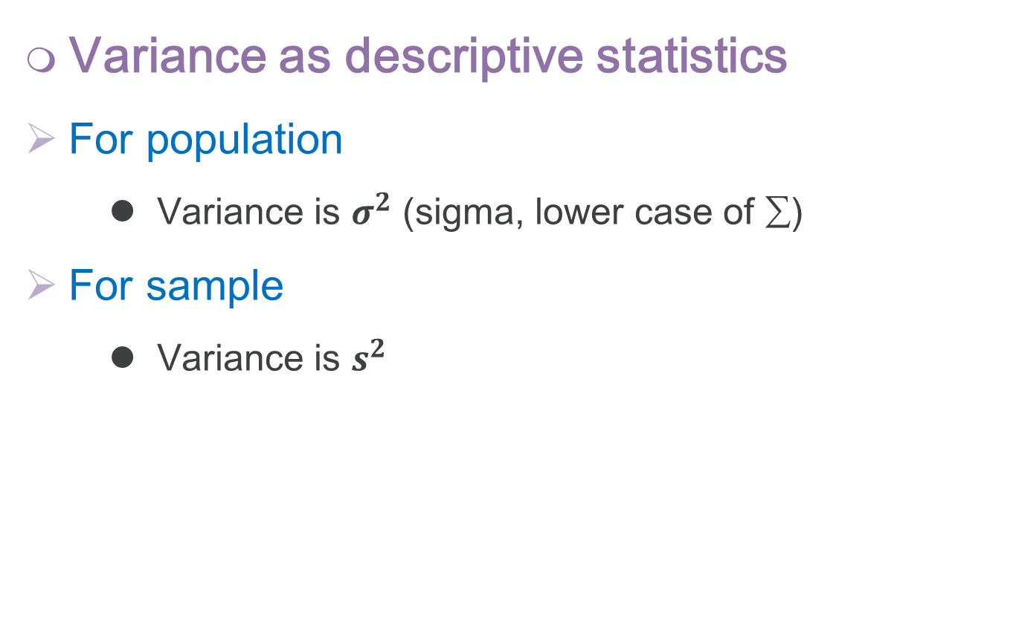
Standard Deviation & Variance
Variance as descriptive statistics
For population
Variance is $σ^{2}$ (sigma, lower case of ∑)
For sample
Variance is $s^{2}$

Slide 39
Standard Deviation & Variance
Standard deviation as descriptive statistics
For population
Standard Deviation is σ (sigma, lower case of ∑)
For sample
Standard Deviation is s (or SD)

Slide 40
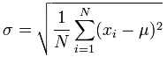
To calculate variance & SD
Sum of Squares
Procedures (for the Population)
1. compute the difference from the population mean for each point
2. Square each distance (squared distance)
3. adds these values together (called Sum of Squares or SS)
4. variance: the mean of the SS
5. σ: take the Square root of variance
Take back the distance!

Slide 41
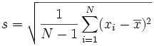
To calculate variance & SD
Procedure (for the sample)
Mostly the same, except
Rather than using N as the dividend of SS, divide SS by (N - 1)
Rather than the population mean, use sample mean
Notes:
N -1 is the degree of freedom when you use estimation. Every time you rely on a statistic from the sample (rather than from the population), you lose one degree of freedom. The reason for “minus 1” is because we are relying on another estimate, the sample mean, to estimate the sample variance and SD.

Slide 42
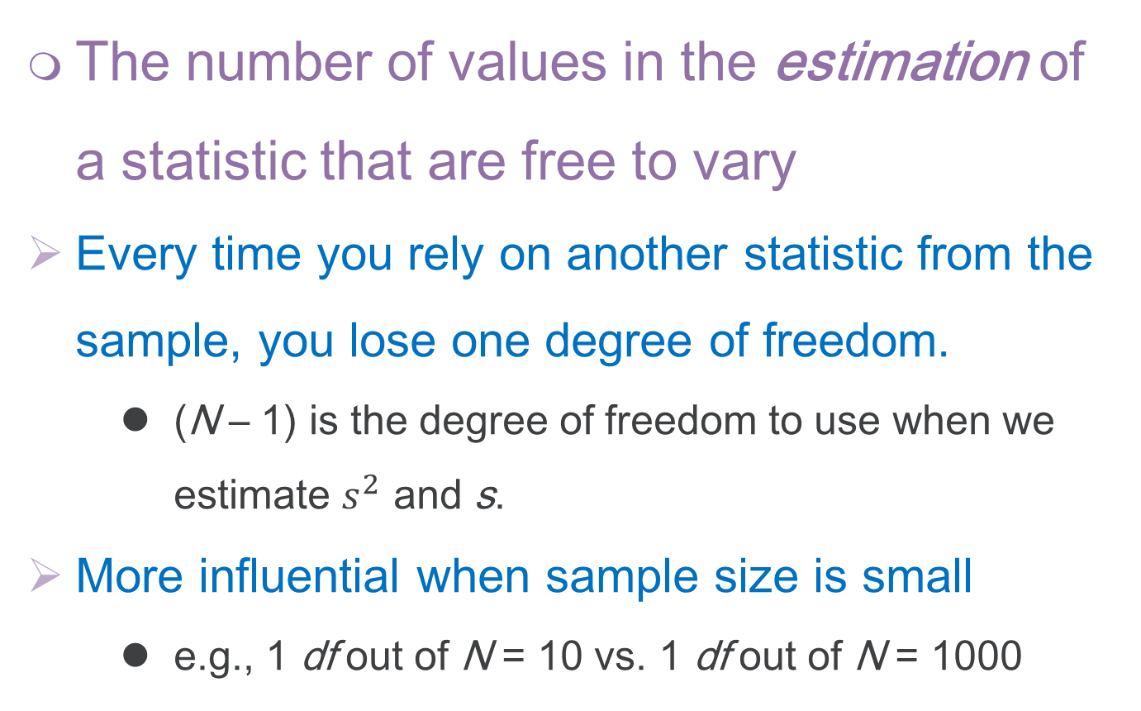
Degree of Freedom (df )
The number of values in the estimation of a statistic that are free to vary
Every time you rely on another statistic from the sample, you lose one degree of freedom.
(N – 1) is the degree of freedom to use when we estimate $s^{2}$ and s.
More influential when sample size is small
e.g., 1 df out of N = 10 vs. 1 df out of N = 1000

Slide 43
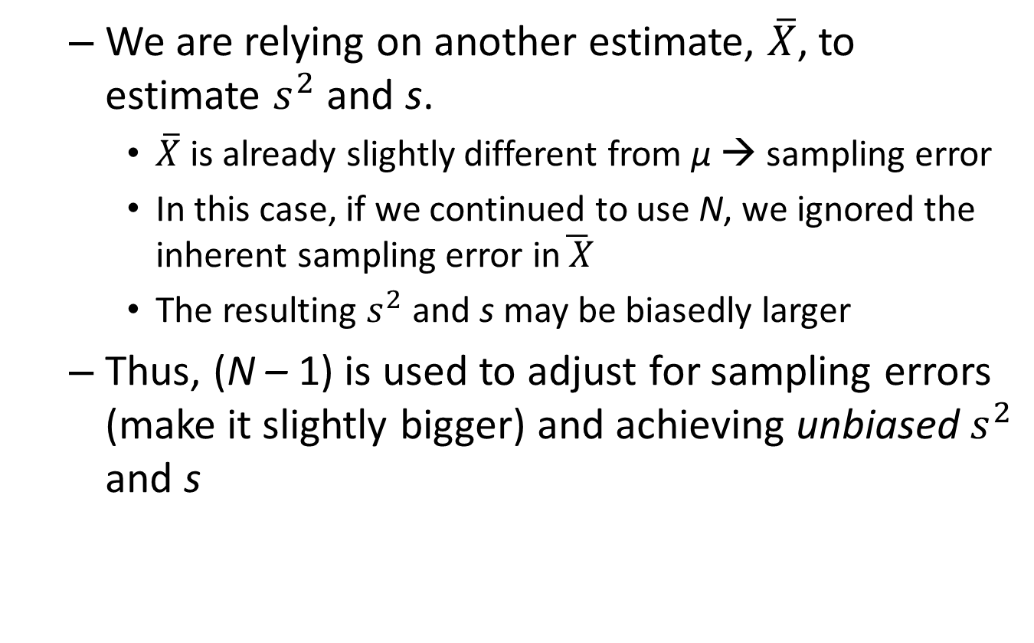
Reason for using (N – 1)
We are relying on another estimate, $\overline{X}$, to estimate $s^{2}$ and s.
$\overline{X}$ is already slightly different from μ → sampling error
In this case, if we continued to use N, we ignored the inherent sampling error in$\overline{ X}$
The resulting $s^{2}$ and s may be biasedly larger
Thus, (N – 1) is used to adjust for sampling errors (make it slightly bigger) and achieving unbiased $s^{2}$ and s

Slide 44
Distribution

Slide 45
Frequency Distribution
Frequency
How often something happens
Distribution
An (organized) arrangement of the values for a variable over its range
Frequency Distribution
An (organized) arrangement of how frequently different values occur over the range of a variable
It can come in either tables or graphs

Slide 46
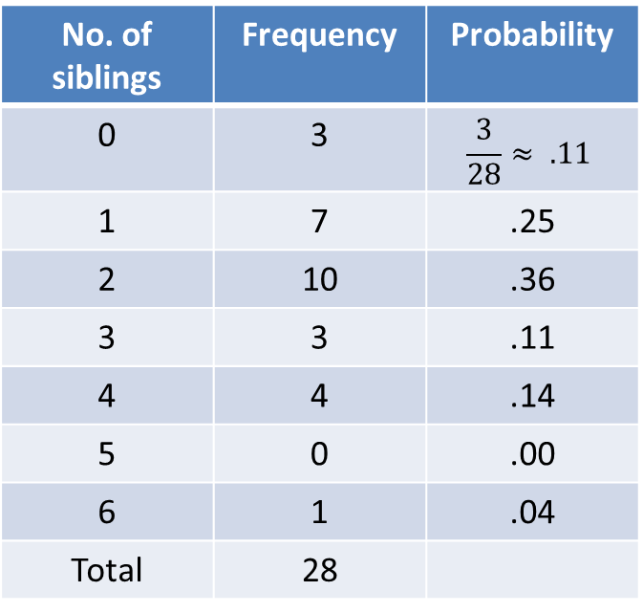
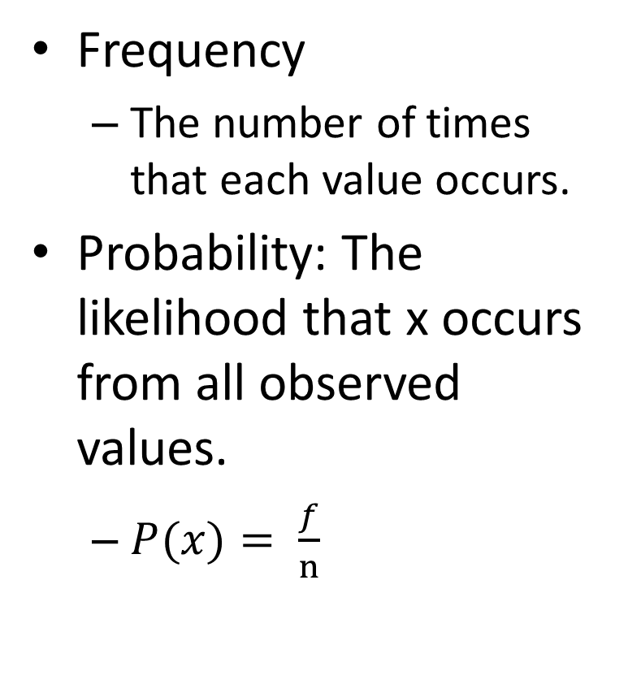
Frequency and Probability
Frequency
The number of times that each value occurs.
Probability: The likelihood that x occurs from all observed values.
$P(x)= \frac{f}{n}$
No. of siblings | Frequency | Probability
0 | 3 | $$\frac{3}{28}≈ .11$$
1 | 7 | .25
2 | 10 | .36
3 | 3 | .11
4 | 4 | .14
5 | 0 | .00
6 | 1 | .04
Total | 28

Slide 47
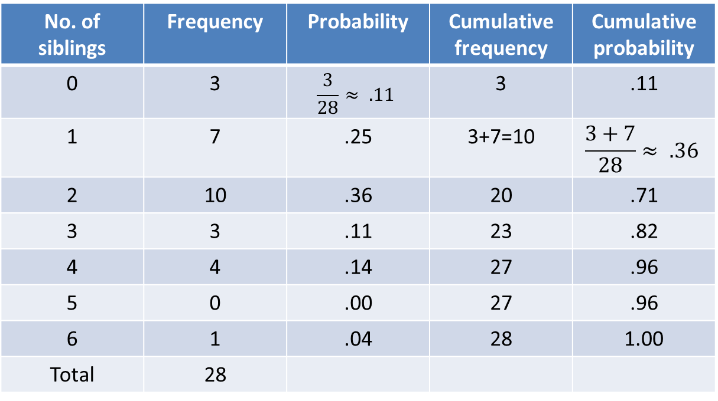
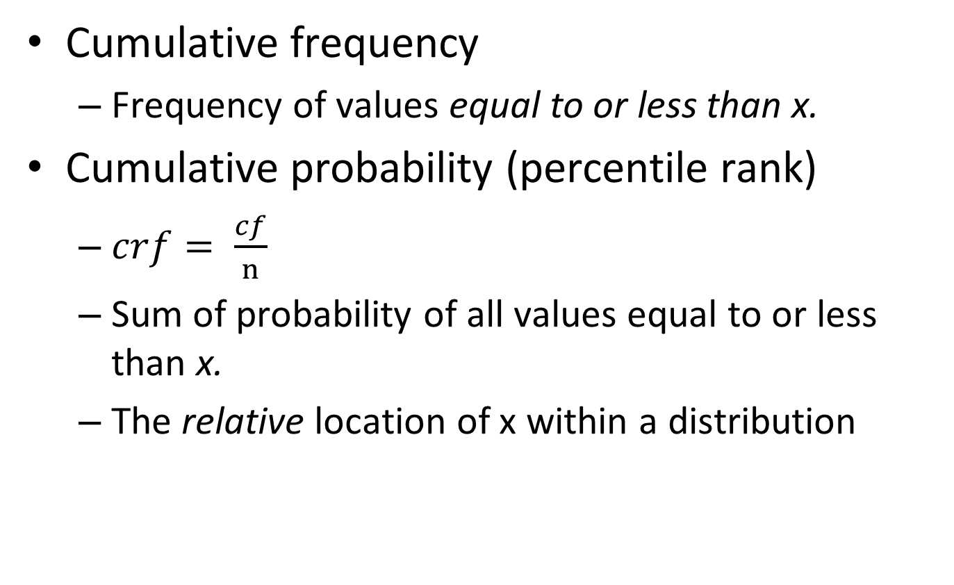
Frequency and Probability
Cumulative frequency
Frequency of values equal to or less than x.
Cumulative probability (percentile rank)
$crf= \frac{cf}{n}$
Sum of probability of all values equal to or less than x.
The relative location of x within a distribution
No. of siblings | Frequency | Probability | Cumulative frequency | Cumulative probability
0 | 3 | $$\frac{3}{28}≈ .11$$ | 3 | .11
1 | 7 | .25 | 3+7=10 | $$\frac{3+7}{28}≈ .36$$
2 | 10 | .36 | 20 | .71
3 | 3 | .11 | 23 | .82
4 | 4 | .14 | 27 | .96
5 | 0 | .00 | 27 | .96
6 | 1 | .04 | 28 | 1.00
Total | 28

Slide 48
Distribution Functions
A function that models the probability (f) as a function of value x
A distribution graph could be drawn based on the function, with value x on the x-axis and probability on the y-axis.
For discrete variables, the distribution function is usually called the probability mass function (PMF).
For continuous variables, the distribution function is usually called the probability density function (PDF).

Slide 49
Cumulative Distribution Functions
A function that models the cumulative probability (F) as a function of value x
A distribution graph could be drawn based on the function, with value x on the x-axis and cumulative probability on the y-axis.

Slide 50
Common Distribution Functions
When x is a discrete variable
Binomial distribution
Poisson distribution
When x is a continuous variable
Normal (z) distribution
Student (t) distribution
More details when we get to t-test.

Slide 51
Binomial Distribution
The probability for the number of times that either/or (thus “bi”nomial) happens after multiple trials.
Suppose an unbiased coin comes up heads with probability 0.5 when tossed. What is the probability of achieving 0, 1, …, 20 heads after 20 tosses?
What is the probability of achieving 0, 1, …, 40 heads after 40 tosses?
Suppose a biased coin comes up heads with probability 0.7 when tossed. What is the probability of achieving 0, 1,..., 20 heads after 20 tosses?

Slide 52
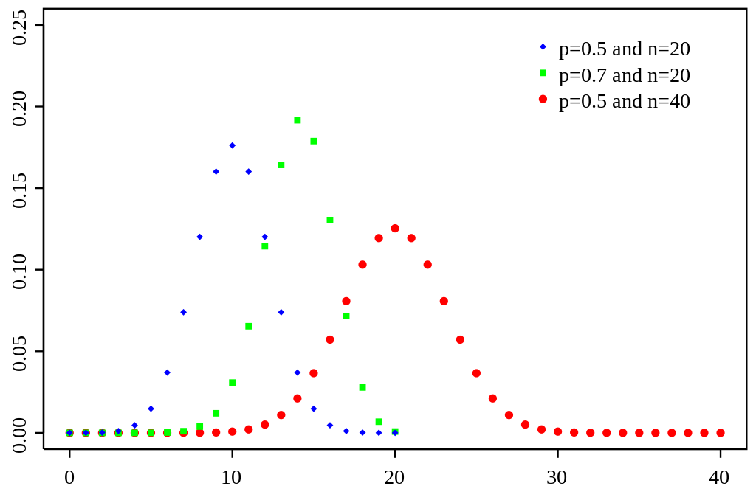
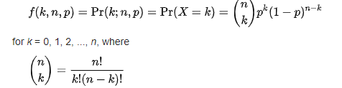
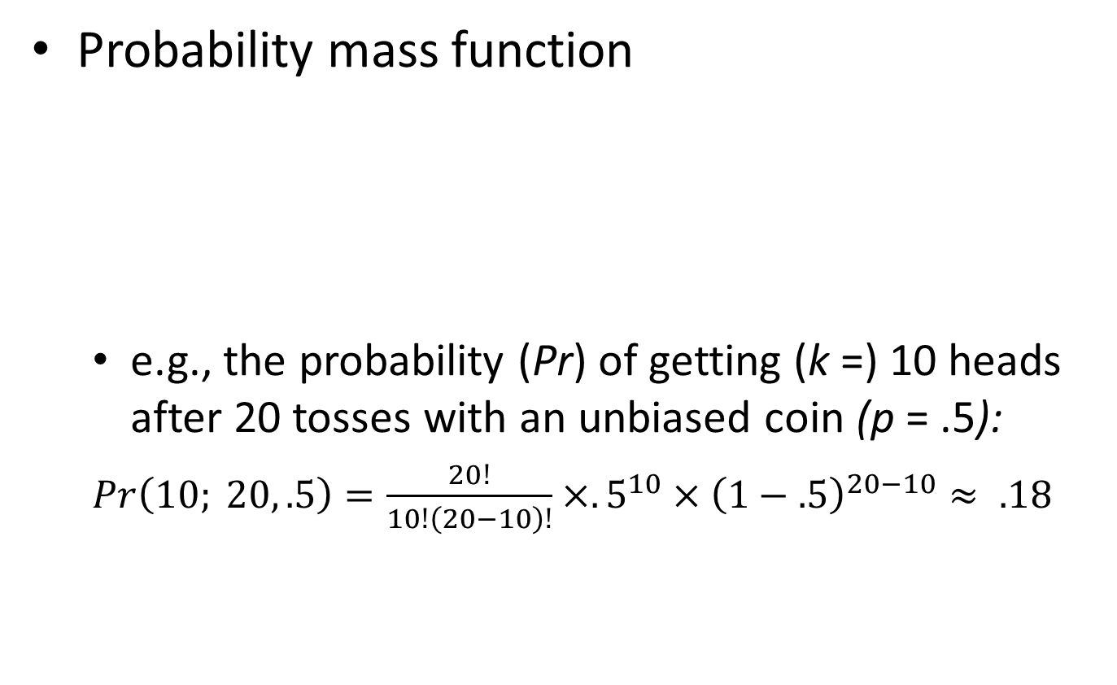
Binomial Distribution
Probability mass function
e.g., the probability (Pr) of getting (k =) 10 heads after 20 tosses with an unbiased coin (p = .5):
$Pr\left(10; 20, .5\right)=\frac{20!}{10!\left(20−10\right)!}×.5^{10}×{\left(1−.5\right)}^{20−10}≈ .18$

Slide 53
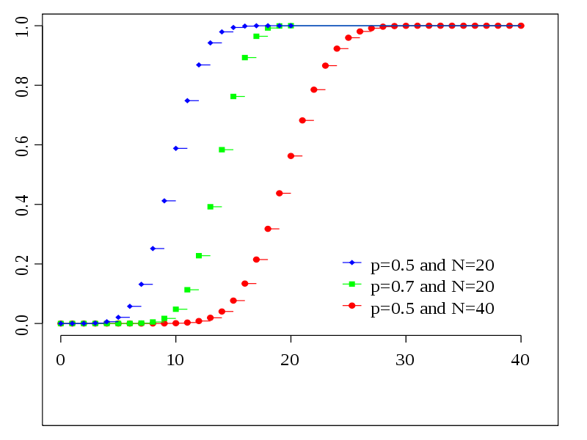
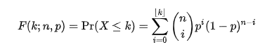
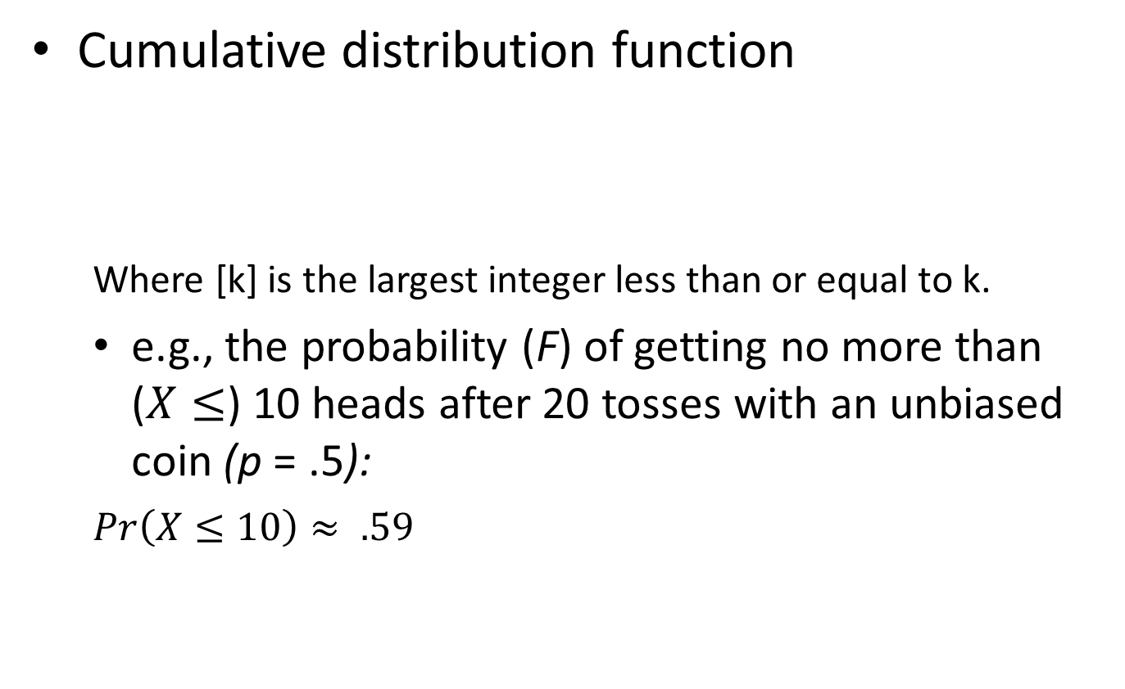
Binomial Distribution
Cumulative distribution function
Where [k] is the largest integer less than or equal to k.
e.g., the probability (F) of getting no more than ($X≤$) 10 heads after 20 tosses with an unbiased coin (p = .5):
$Pr\left(X≤10\right)≈ .59$

Slide 54
Poisson Distribution
The probability for the number of times that an event occurs given a certain averaged event rate.
Assumptions:
Events are countable but are discrete values;
Events occur independently;
Rate at which events occur is constant;
Two events cannot occur at exactly the same instant.
E.g., The probability that 0, 1, …, 20 patients entering the UW medicine if:
Averagely 1 patient enters during 7-8 am;
Averagely 4 patients enter during 9-10 am;
Averagely 10 patients enter during 10-11 am.

Slide 55
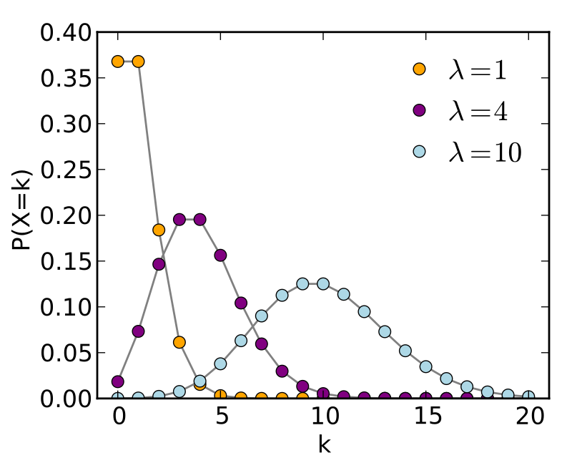
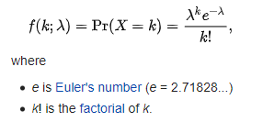
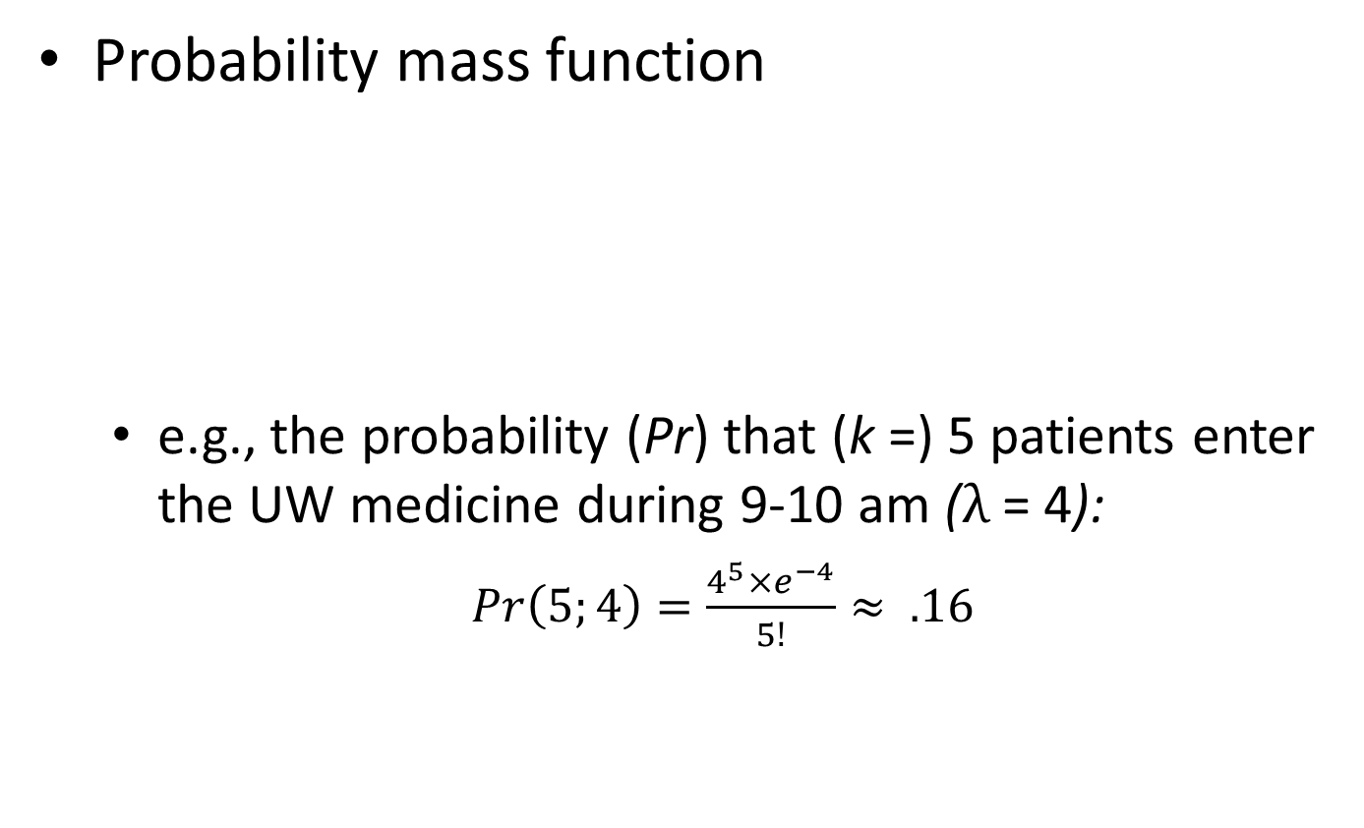
Poisson Distribution
Probability mass function
e.g., the probability (Pr) that (k =) 5 patients enter the UW medicine during 9-10 am ($λ$ = 4):
$Pr\left(5;4\right)=\frac{4^{5}×e^{−4}}{5!}≈ .16$

Slide 56
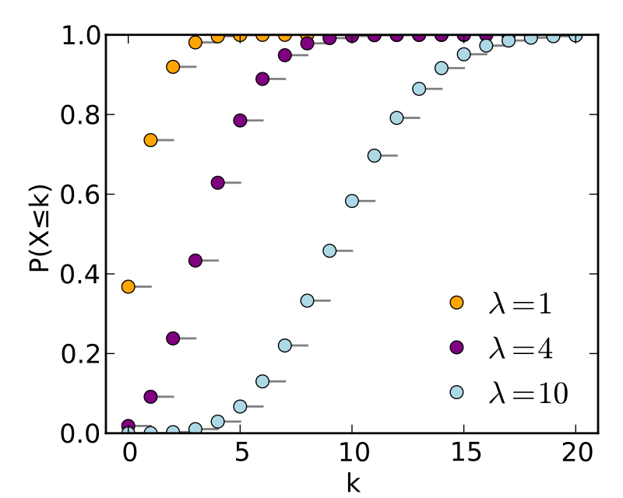
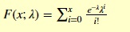
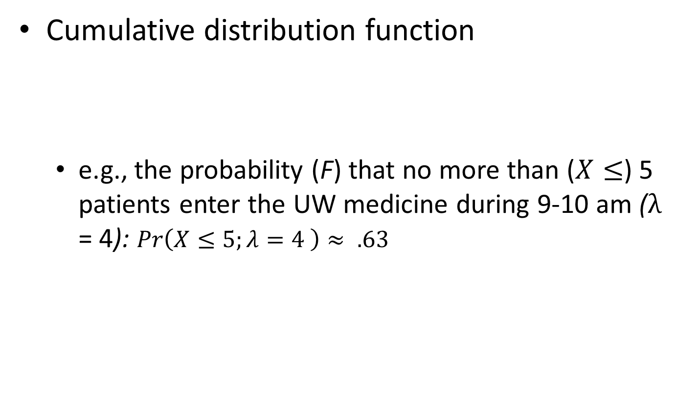
Poisson Distribution
Cumulative distribution function
e.g., the probability (F) that no more than ($X≤$) 5 patients enter the UW medicine during 9-10 am ($λ$ = 4): $Pr\left(X≤5;λ=4 \right)≈ .63$

Slide 57
Normal Distribution
The probability of a specific value given a certain population mean and variance.
Also called Gaussian distribution.
Mean = median = mode
Symmetrical
Same amount of area on either side of the population mean

Slide 58
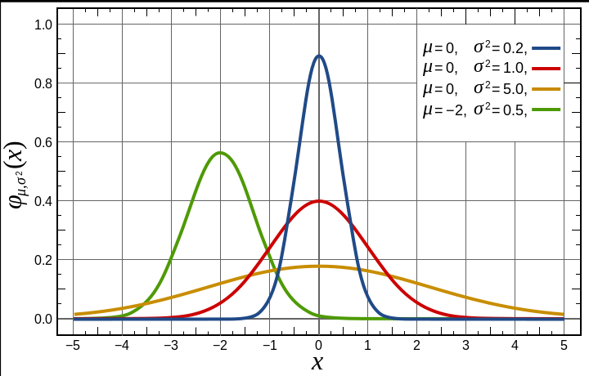
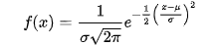
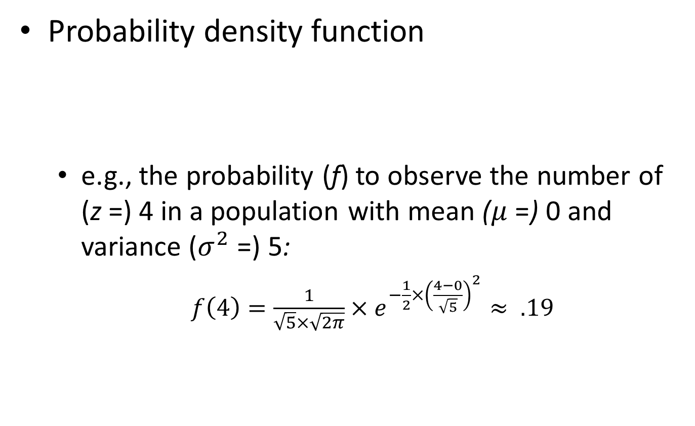
Normal Distribution
Probability density function
e.g., the probability (f) to observe the number of (z =) 4 in a population with mean ($μ$ =) 0 and variance ($σ^{2}$ =) 5:
$f\left(4\right)=\frac{1}{\sqrt{5}×\sqrt{2π}}×e^{−\frac{1}{2}×{\left(\frac{4−0}{\sqrt{5}}\right)}^{2}}≈ .19$
Notes:
The red line is the standard normal distribution

Slide 59
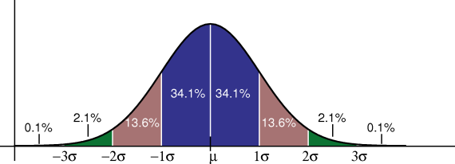
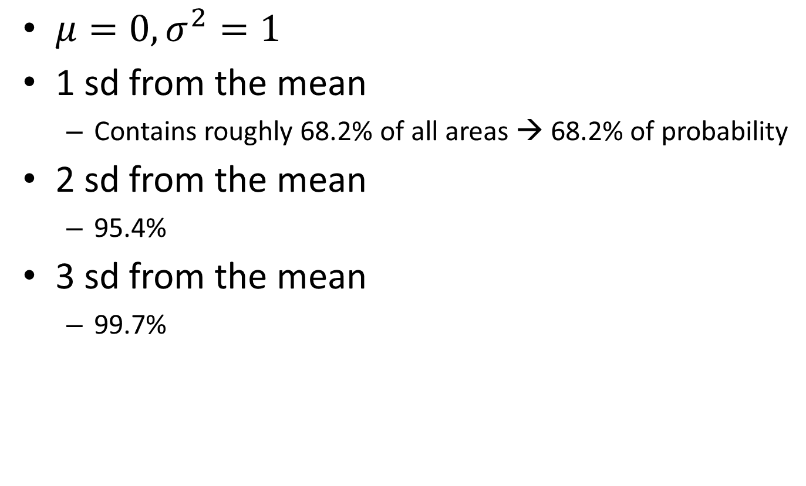
Standard Normal Distribution
$μ=0, σ^{2}=1$
1 sd from the mean
Contains roughly 68.2% of all areas → 68.2% of probability
2 sd from the mean
95.4%
3 sd from the mean
99.7%

Slide 60
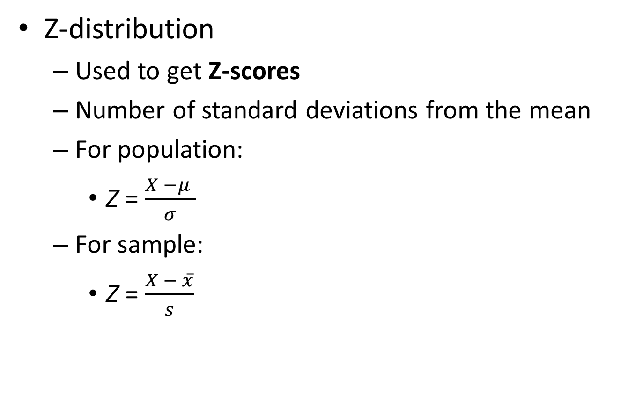
Standard Normal distribution
Z-distribution
Used to get Z-scores
Number of standard deviations from the mean
For population:
Z = $\frac{X −μ }{σ}$
For sample:
Z = $\frac{X − \overline{x}}{s}$

Slide 61
Z-score
Tells us exactly where one data point is located in the distribution:
The sign of the z-score (+ or -) identifies whether that particular score is above or below the mean
+ : above the mean
- : below the mean
Examples
Someone got an IQ of 130. What is his/her z-score?
Someone got an IQ of 70. What is his/her z-score?

Slide 62
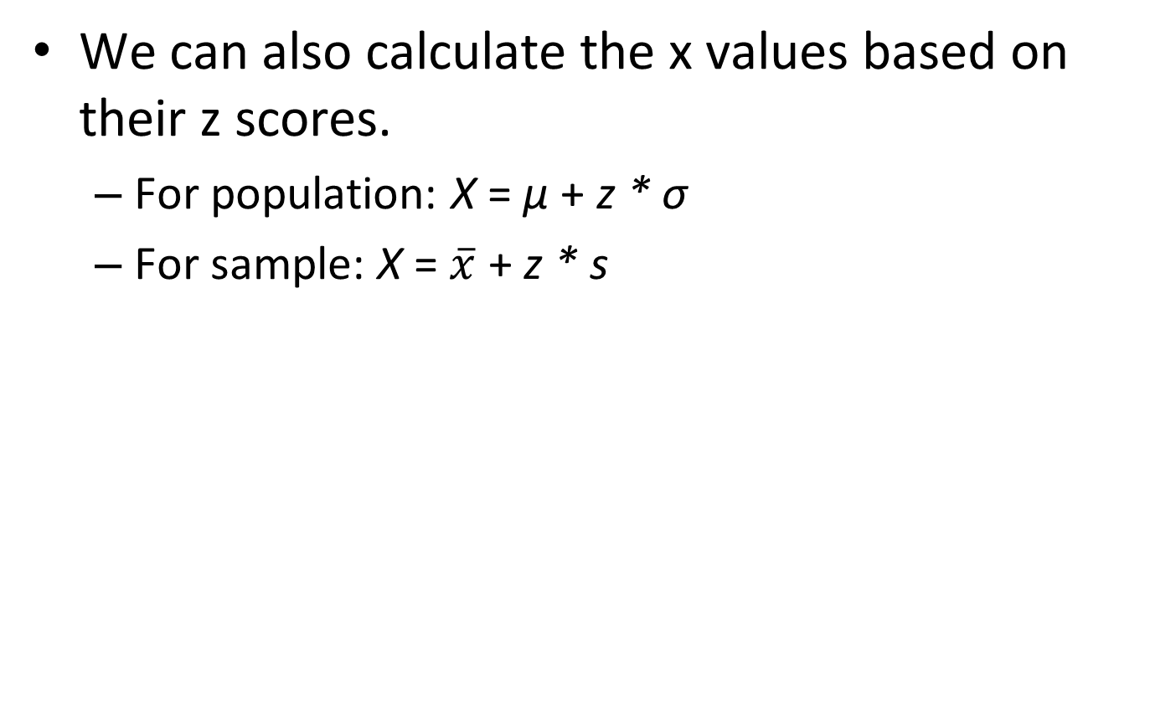
Going from z back to X
We can also calculate the x values based on their z scores.
For population: X = μ + z * σ
For sample: X = $\overline{x}$ + z * s

Slide 63
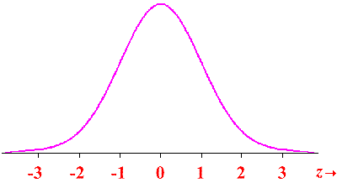
Z-score → probability
Z-scores can also be used to find the probability
Each z-score has a cumulative probability
The area to the left of the z-score

Slide 64
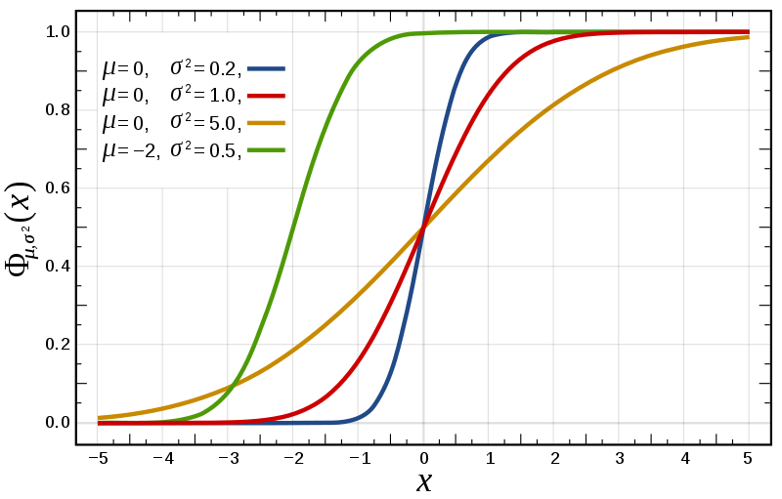
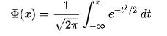
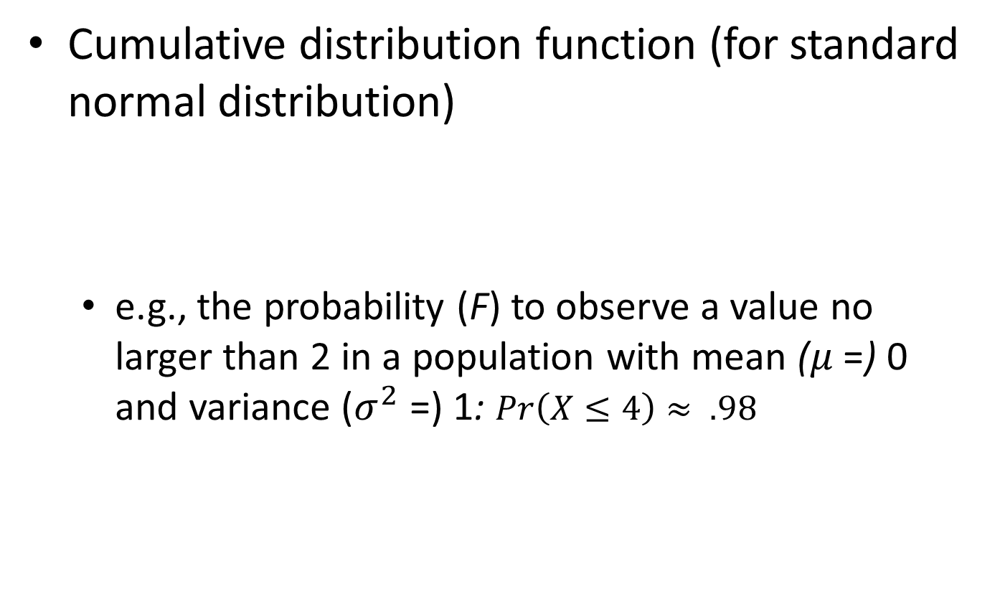
Normal Distribution
Cumulative distribution function (for standard normal distribution)
e.g., the probability (F) to observe a value no larger than 2 in a population with mean ($μ$ =) 0 and variance ($σ^{2}$ =) 1: $Pr\left(X≤4\right)≈ .98$

Slide 65
Z-test
Basically it is a series of transformations
Data point → z-score → probability
E.g., IQ of 115 → z = 1 → probability = 84%

Slide 66
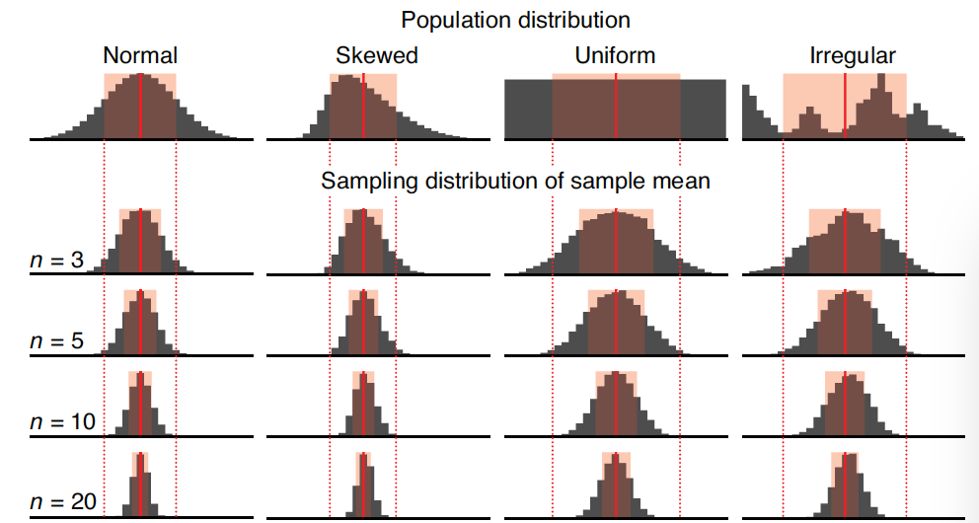
Central Limit Theorem (CLT)
Super important concept alert!
As n increases, the distribution of sample means becomes more normal, regardless of population distribution shape
Nature, 2013. Importance of being uncertain.

Slide 67
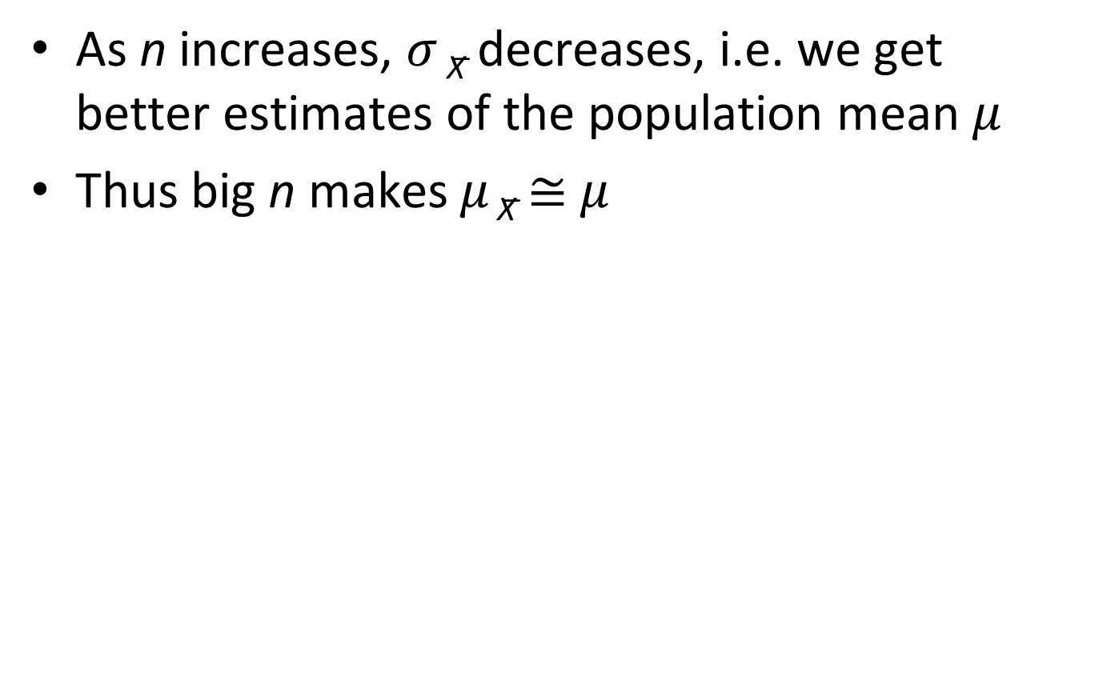
Central Limit Theorem (CLT)
As n increases, $σ$ _{X̅} decreases, i.e. we get better estimates of the population mean 𝜇
Thus big n makes 𝜇 _{X̅} ≅ 𝜇
Nature, 2013. Importance of being uncertain.

Slide 68
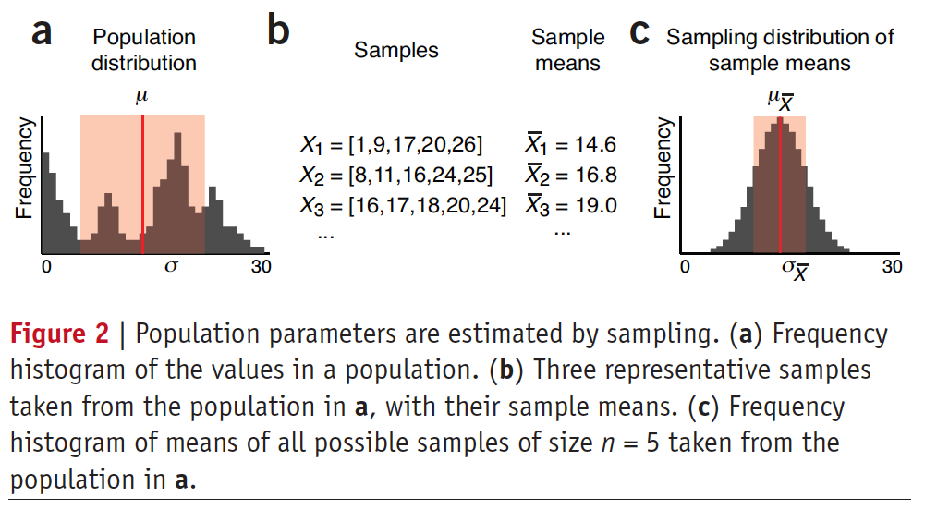
Central Limit Theorem (CLT)
Increasing sample size improves estimates
Nature, 2013. Importance of being uncertain.

Slide 69
Central Limit Theorem (CLT)
Related concept: Confidence interval
How confident we are when obtaining a certain estimate.
Assuming that we sample enough times such that the estimate follows a distribution conforming to the central limit theorem (i.e., a normal distribution).
Thus, we can obtain an interval that describes the probability distribution of the estimate.
This is the confidence interval.

Slide 70
Central Limit Theorem (CLT)
Related concept: Confidence interval
Usually, we use the 95% confidence interval
This is related to the significance level of .05, which we will come back to when talking about hypothesis testing.

